Slide 1
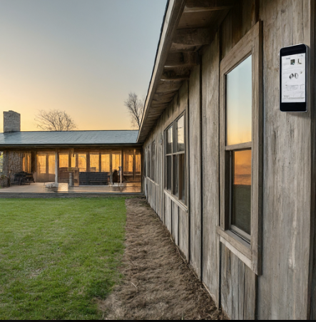
LongHaus Climate Control
Group: 15
Dieter Steinhauser | Lucas Mueller Elizavetta Stetsenko | Nikodem Gazda
EEL 5739 Final Presentation

Slide 2
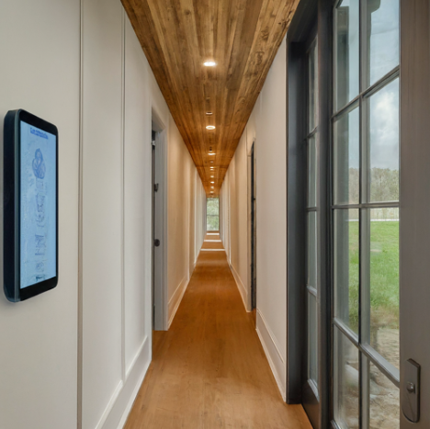
Demo
Notes:
Recorded or live demonstration of project (20 points):
Includes at least 2 devices communicating over MQTTS

Slide 3
Project Description
Sensors
Humidity and temperature
Platform
ESP32
Software
PlatformIO
Network Structure
Two ESP MQTT nodes publish data to AWS
"Longhaus" IOT AC control system
Several devices monitor temperature and humidity and send to one thermostat device through AWS broker
If values are outside of a predefined threshold, a thermostat device activates the AC/dehumidifier
Notes:
Description of project problem and solution with particular focus on (10 points):
Sensors used
Computational platform used
Software used
Network Structure

Slide 4
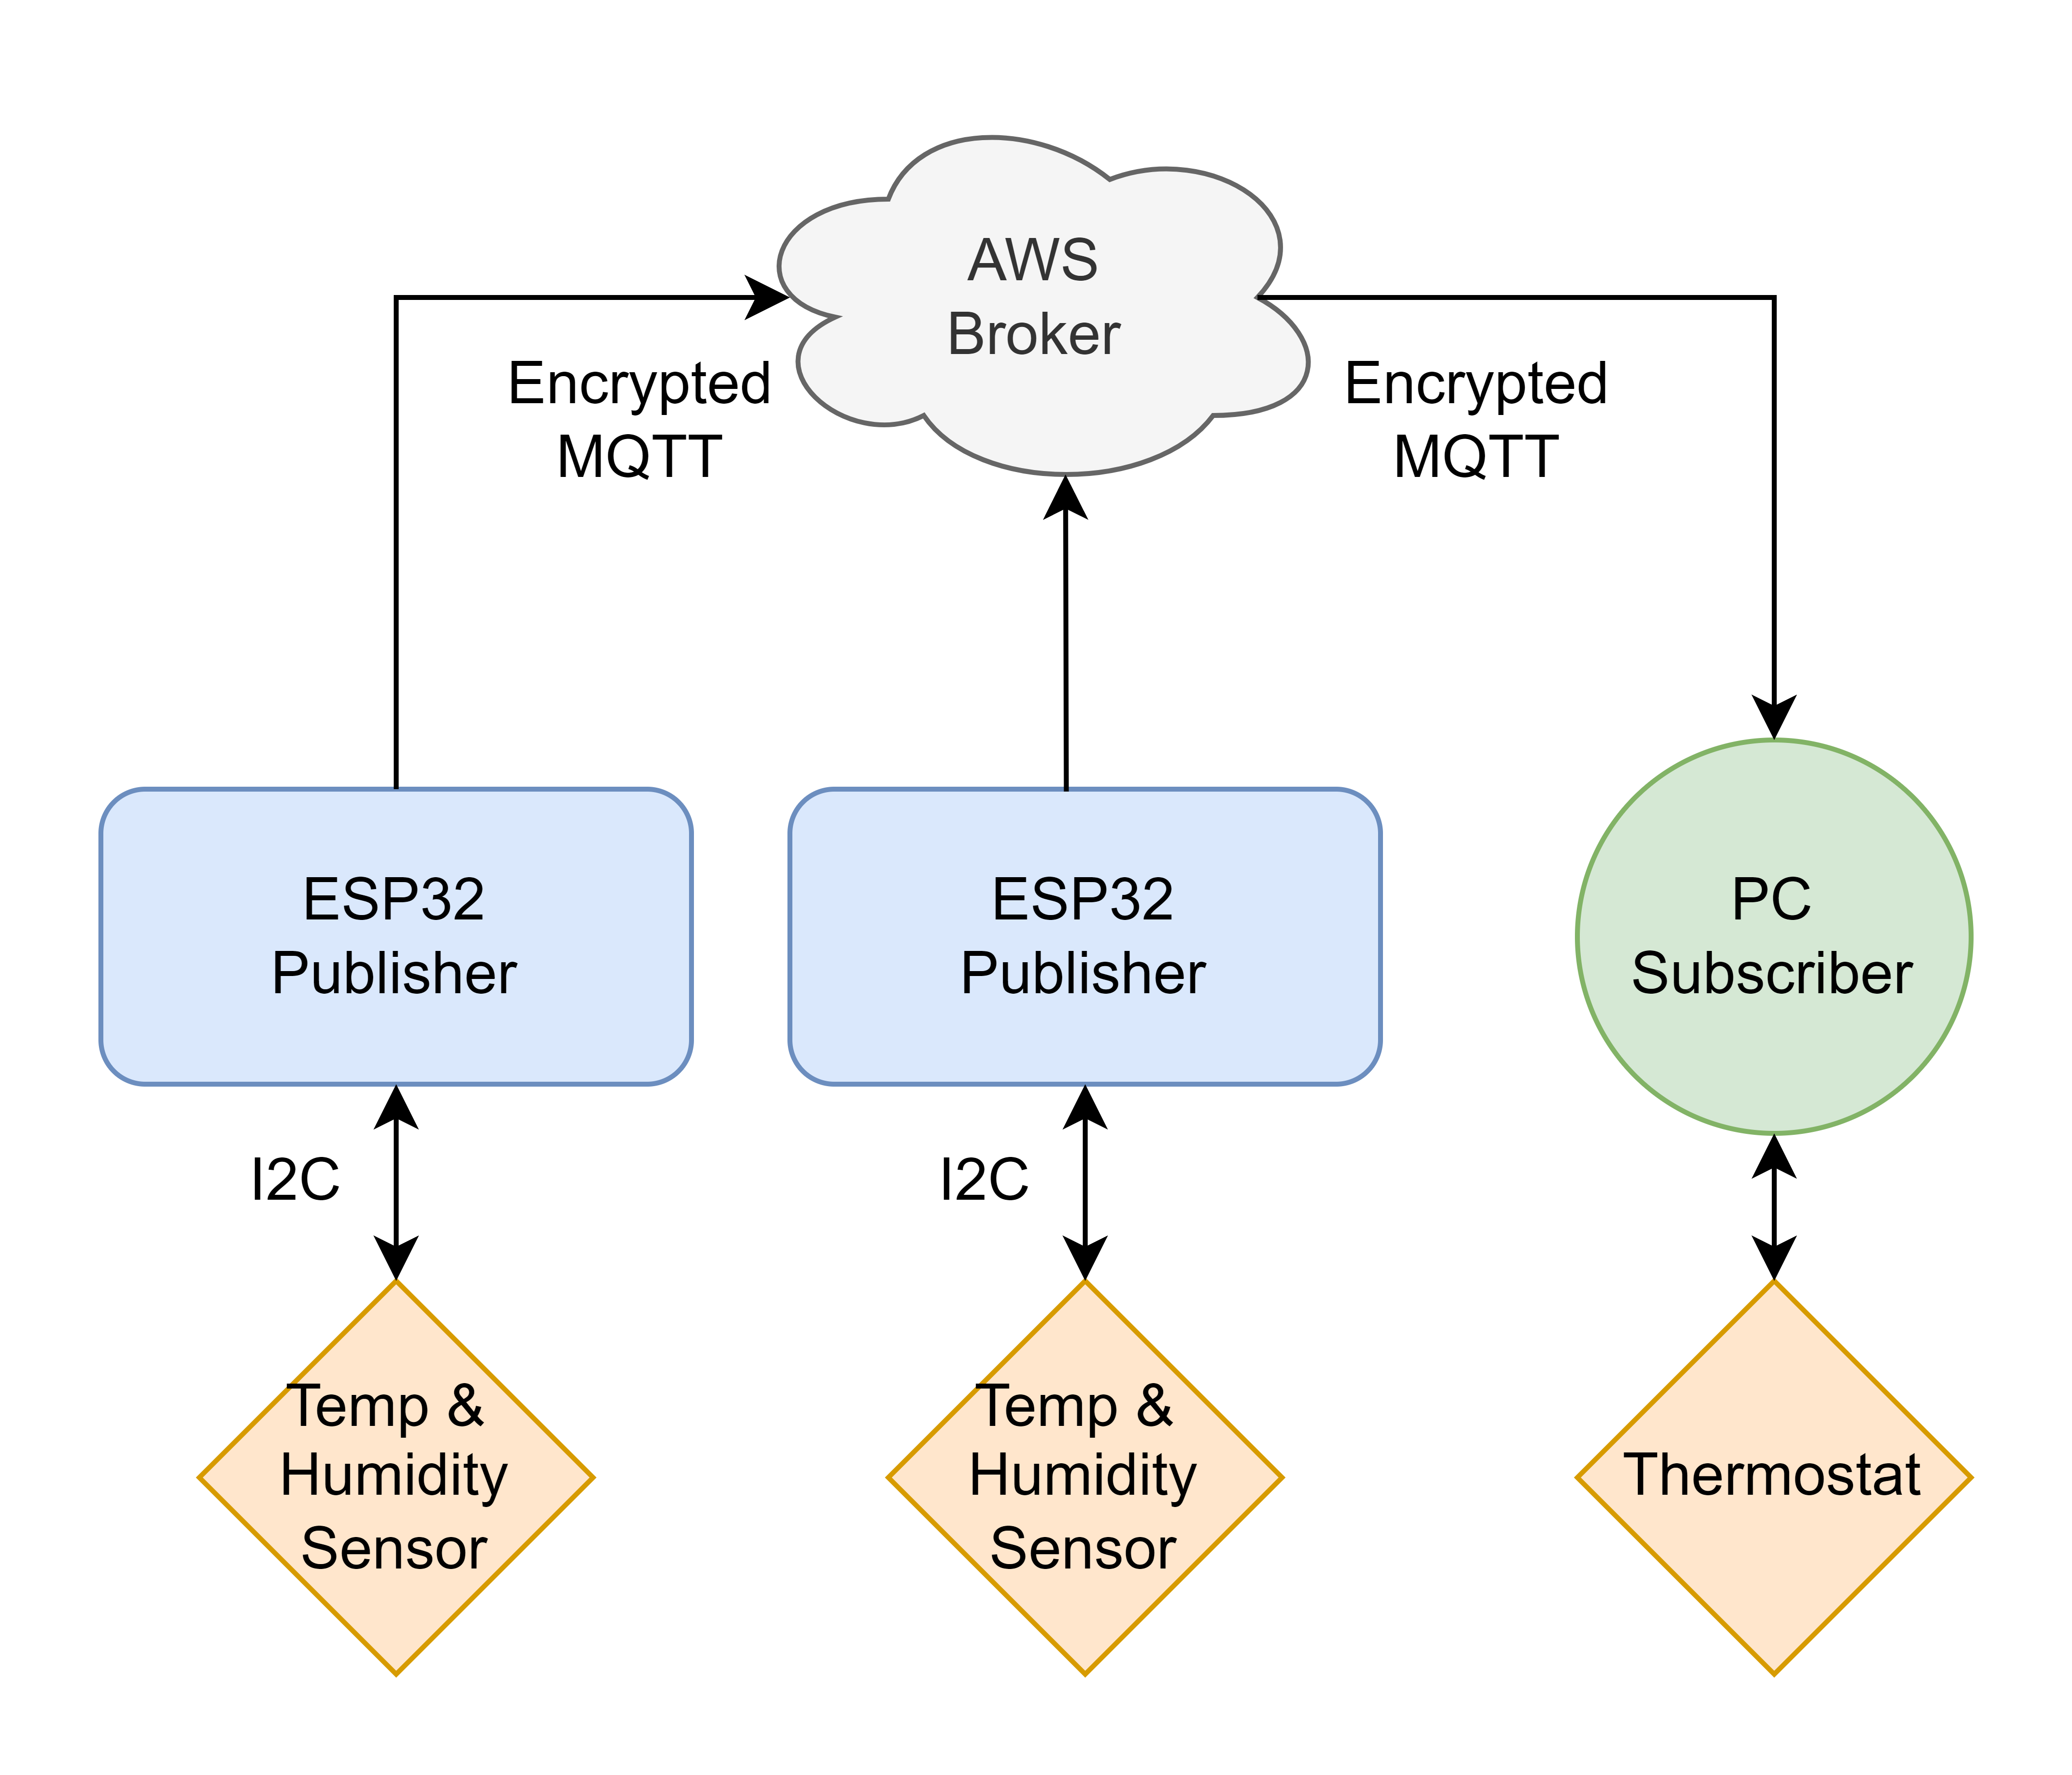
Design Implementation
2+ ESP32 devices collecting sensor information are connected to MQTTS topic "LongHaus"
Each device publishes encrypted messages containing the device ID, temperature, and humidity to the AWS broker
One thermostat device subscribed to the topic receives the messages and controls the AC and dehumidifier based on pre-set thresholds
AWS policies ensure only approved devices are able to connect, publish, and subscribe to the system

Slide 5
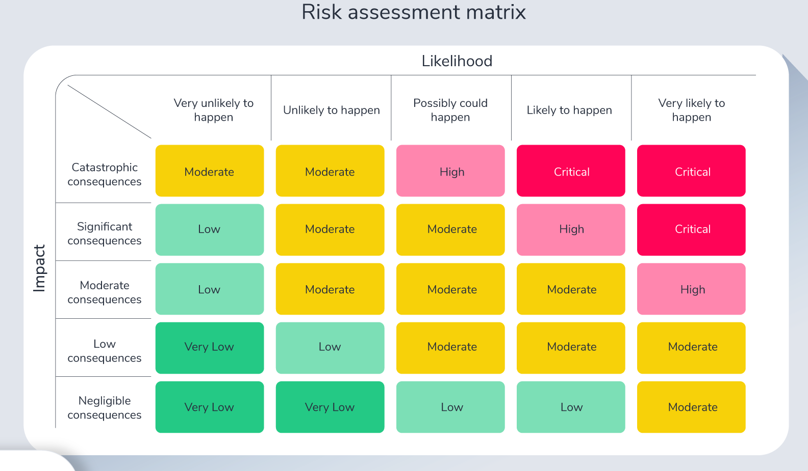
Risk Assessment Matrix
Risk | Threat | Vulnerability | Rating
Causing damage to the board | 4 | 2 | 8
Tampering with the ports | 5 | 2 | 10
Sniffing data packets | 4 | 2 | 8
Access to other devices connected to the network | 5 | 1 | 5
Out of date software | 3 | 3 | 9
RSA key access | 5 | 2 | 10
Risk = Threat x Vulnerability

Slide 6

Risk Analysis
Risk Mitigation:
Store encryption keys and network data in encrypted memory.
Tamper resistant chassis
Obscure Serial bus.
IoT Device VLAN to isolate network exposure.
Risk Transference:
Outsourcing security updates to cybersecurity firm.
Install location and physical access is dependent on the homeowner.
IoT targeted insurance Policy.
Using AWS defers risk of broker to a datacenter.

